Slide 1
PM2.5 prediction
- Pranav Nambiar

Slide 2
Details
Github: https://github.com/PranavNambiar123/PM2.5-Prediction-Project-IIT-Kanpur
Roll number: 233562458
IITK email: nambiarpv23@iitk.ac.in

Slide 3
Previously
We cleaned data using different cleaning methods: linear interpolation, spatial average or mean, median methods
Passed this cleaned data through a linear regression
This presentation we go through gradient boosting and checking how it works and how it compares against linear regression

Slide 4
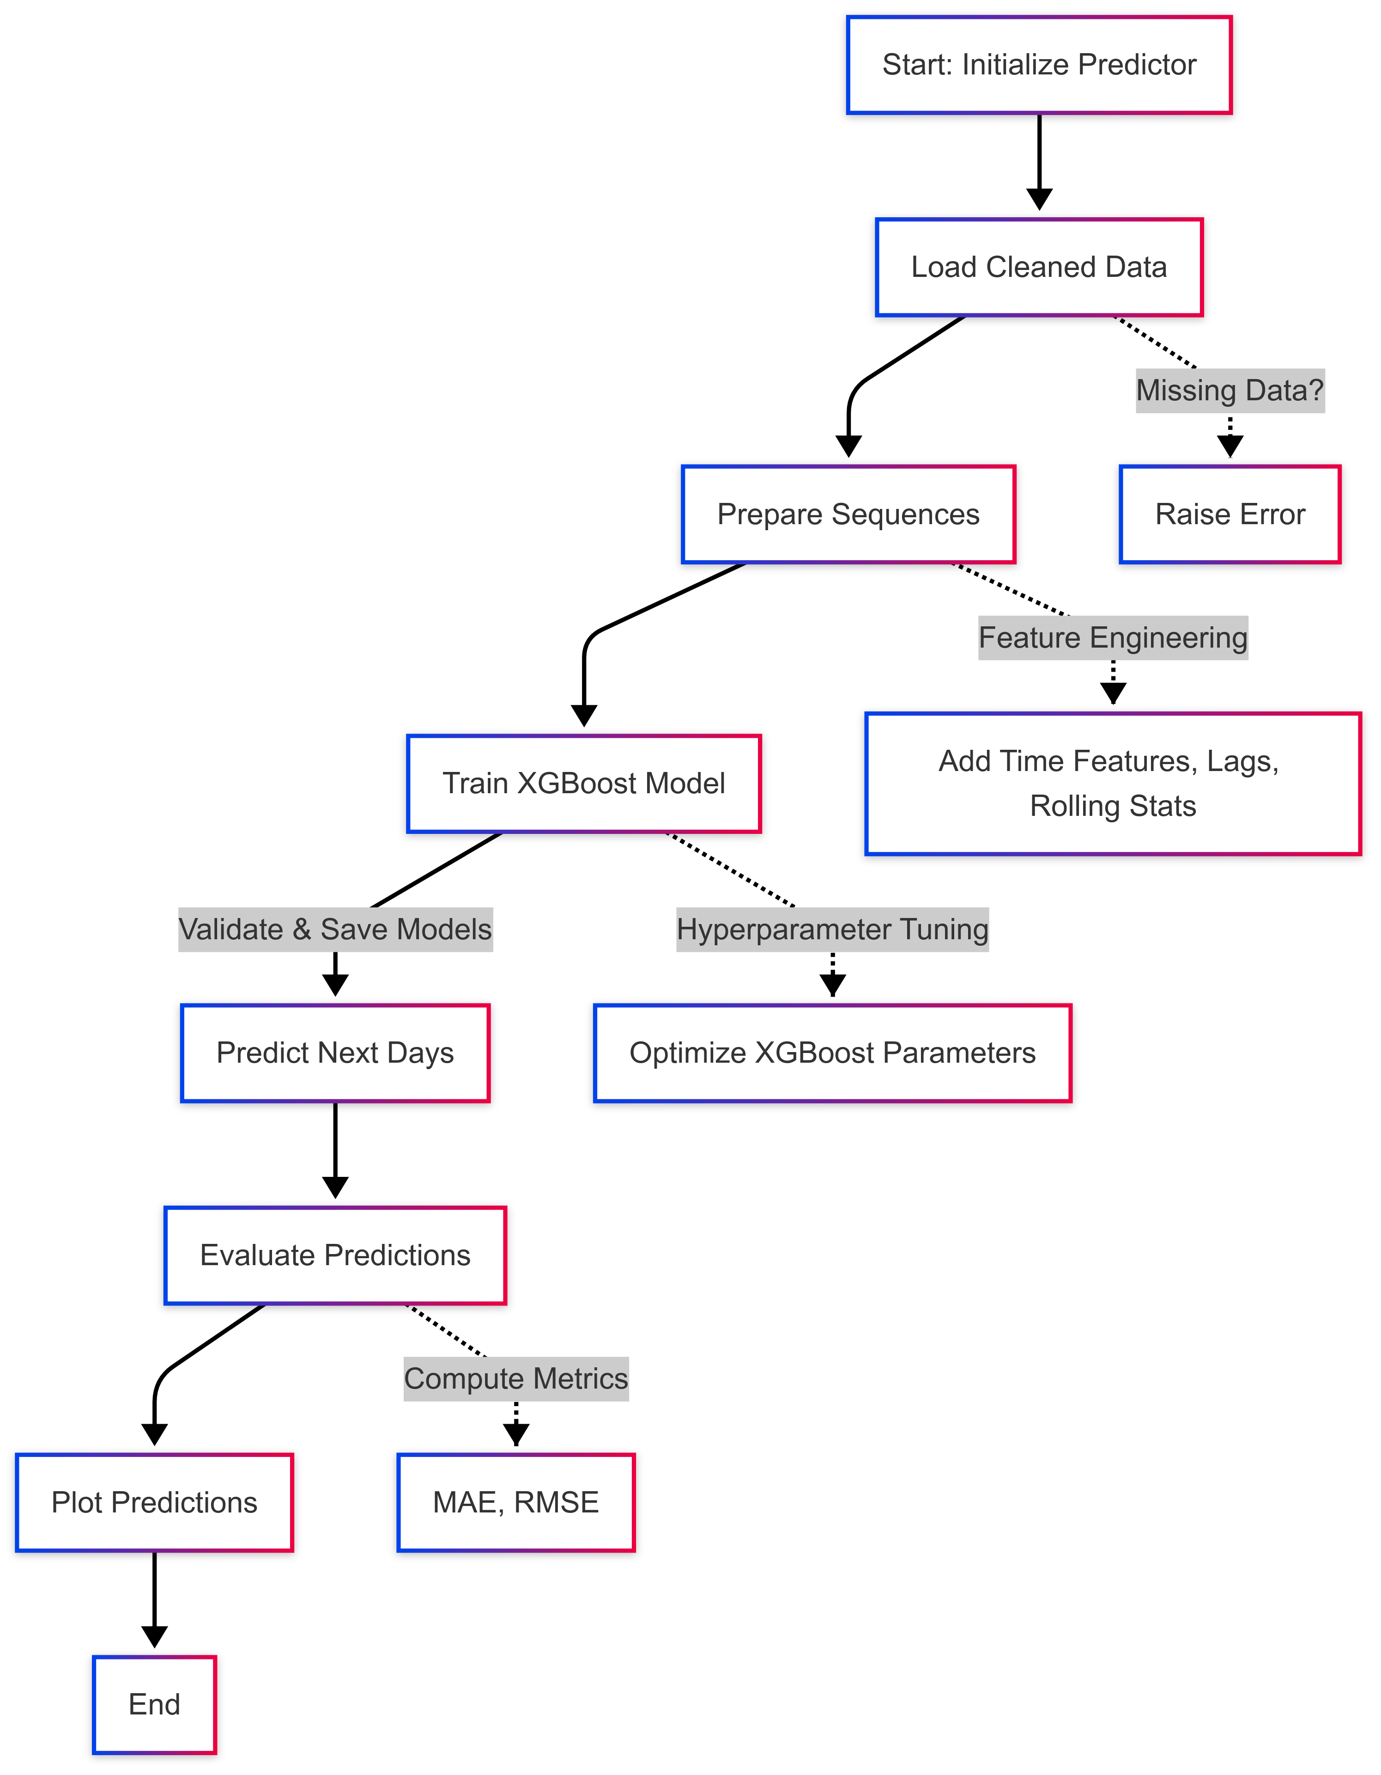
Overall Flow

Slide 5
Gradient Boosting
XGBoost is a good algorithm for PM2.5 prediction generally
As we have interactions between different factors
Also xgboost internally handles null or Nan data points
Also includes L1 and L2 regularisation
The downside is that it is very memory intensive, as it creates an ensemble of decision trees the memory requires to store the model increases linearly with the number of trees.
We used number of trees = 200 and max depth = 8 for our training

Slide 6
Issue faced and optimisations
Faced a lot of issues with size and memory used for training as the system was not able to handle the full load during training Here are the key optimizations we made to improve memory usage and prevent overheating:
Data Loading & Processing:
Chunked CSV reading (1000 rows per chunk)
Minimal feature set (only hour_sin and rolling_mean_6h)
Aggressive memory cleanup between operations
Training Architecture:
Split data into 4 chunks for incremental training
Sequential horizon processing instead of parallel
Reduced batch size to 64
Progressive model updates instead of full retraining
Resource Management:
Testing with single locality first
Added cooldown periods (10s between chunks)
Memory cleanup after each horizon
Longer pauses (60s) when resources are high
Feature Reduction:
Removed less important features
Simplified time features
Using only basic rolling statistics
Efficient numpy operations for sequences
These changes significantly reduced memory usage while maintaining model functionality, though we're still seeing some resource constraints. The key tradeoff was reducing data resolution and feature complexity to improve processing efficiency.
DoneFeedback has been submitted
Start with History ⌘⏎
Press Enter again to interrupt and send a new message
Start with History ⌘⏎
Write
Chat

Slide 7
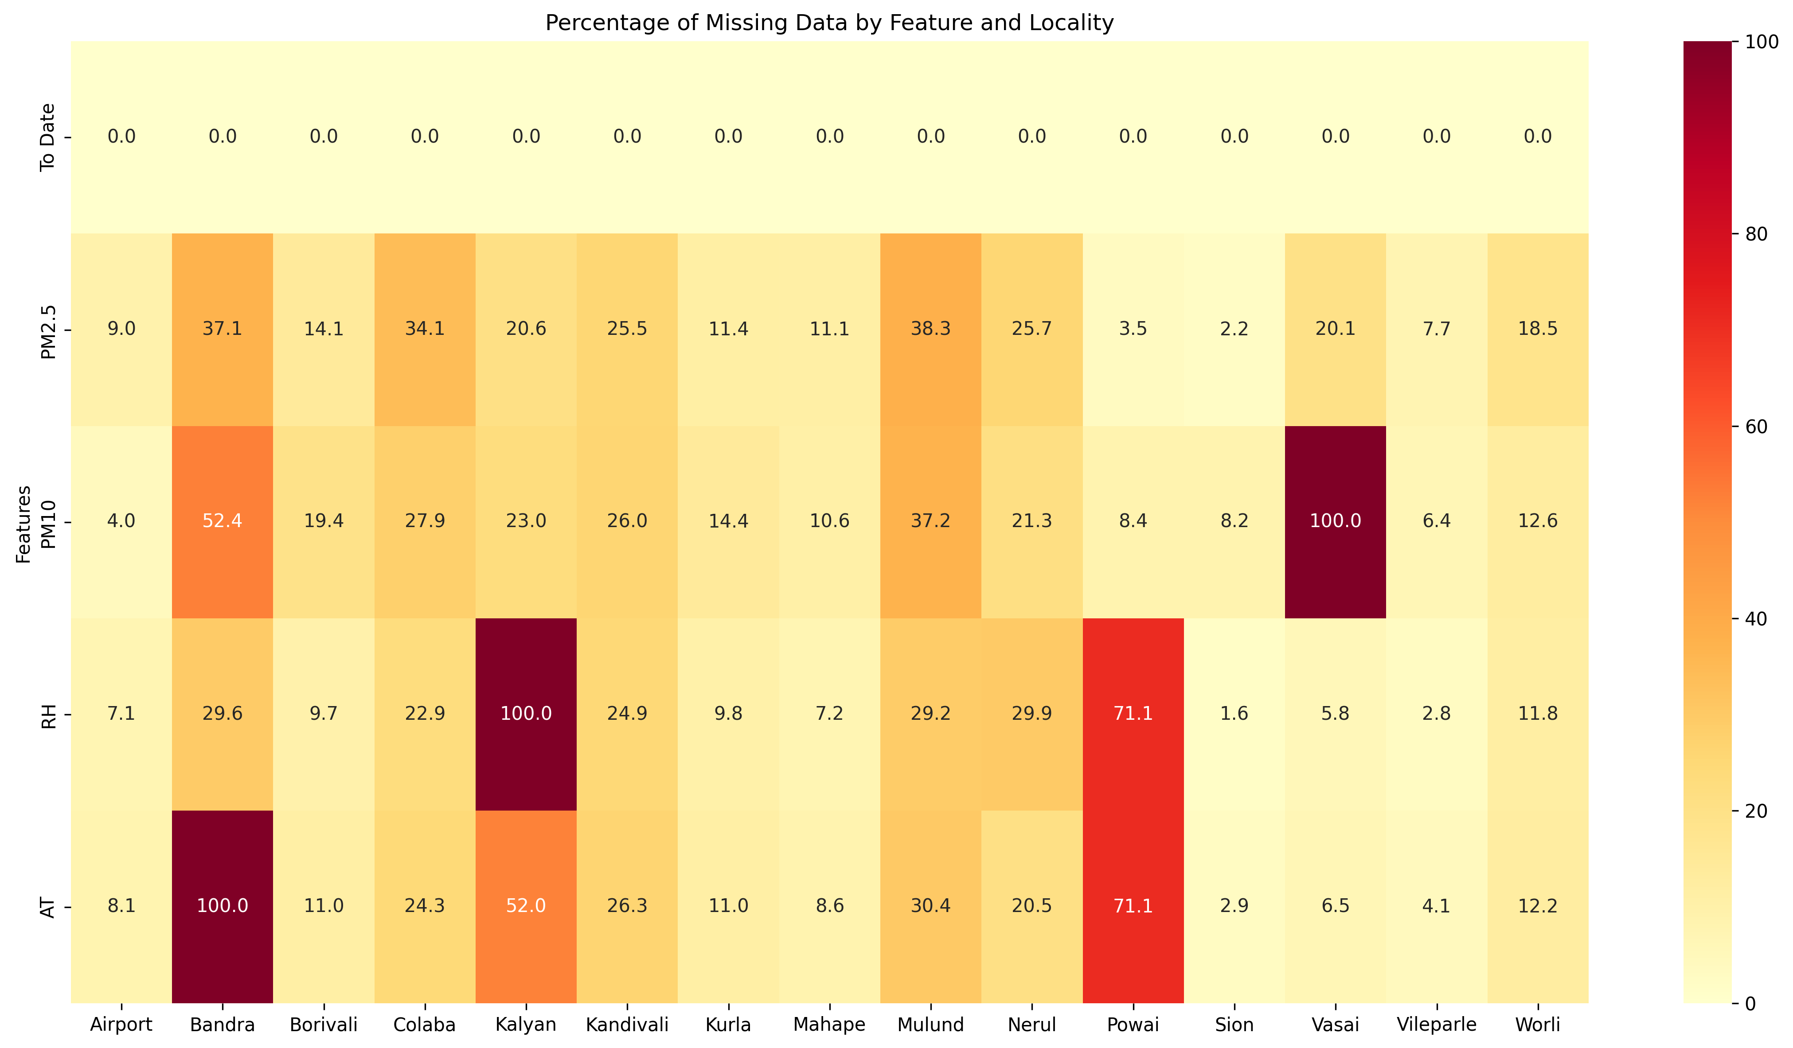
Given the data distribution for each region

Slide 8
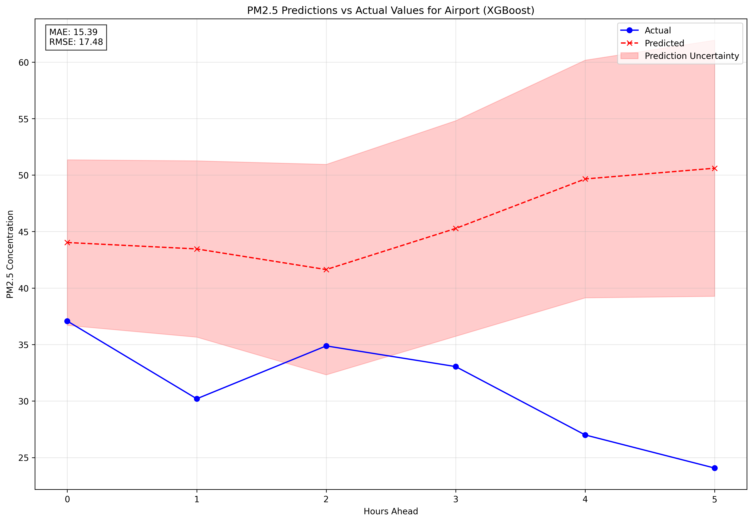
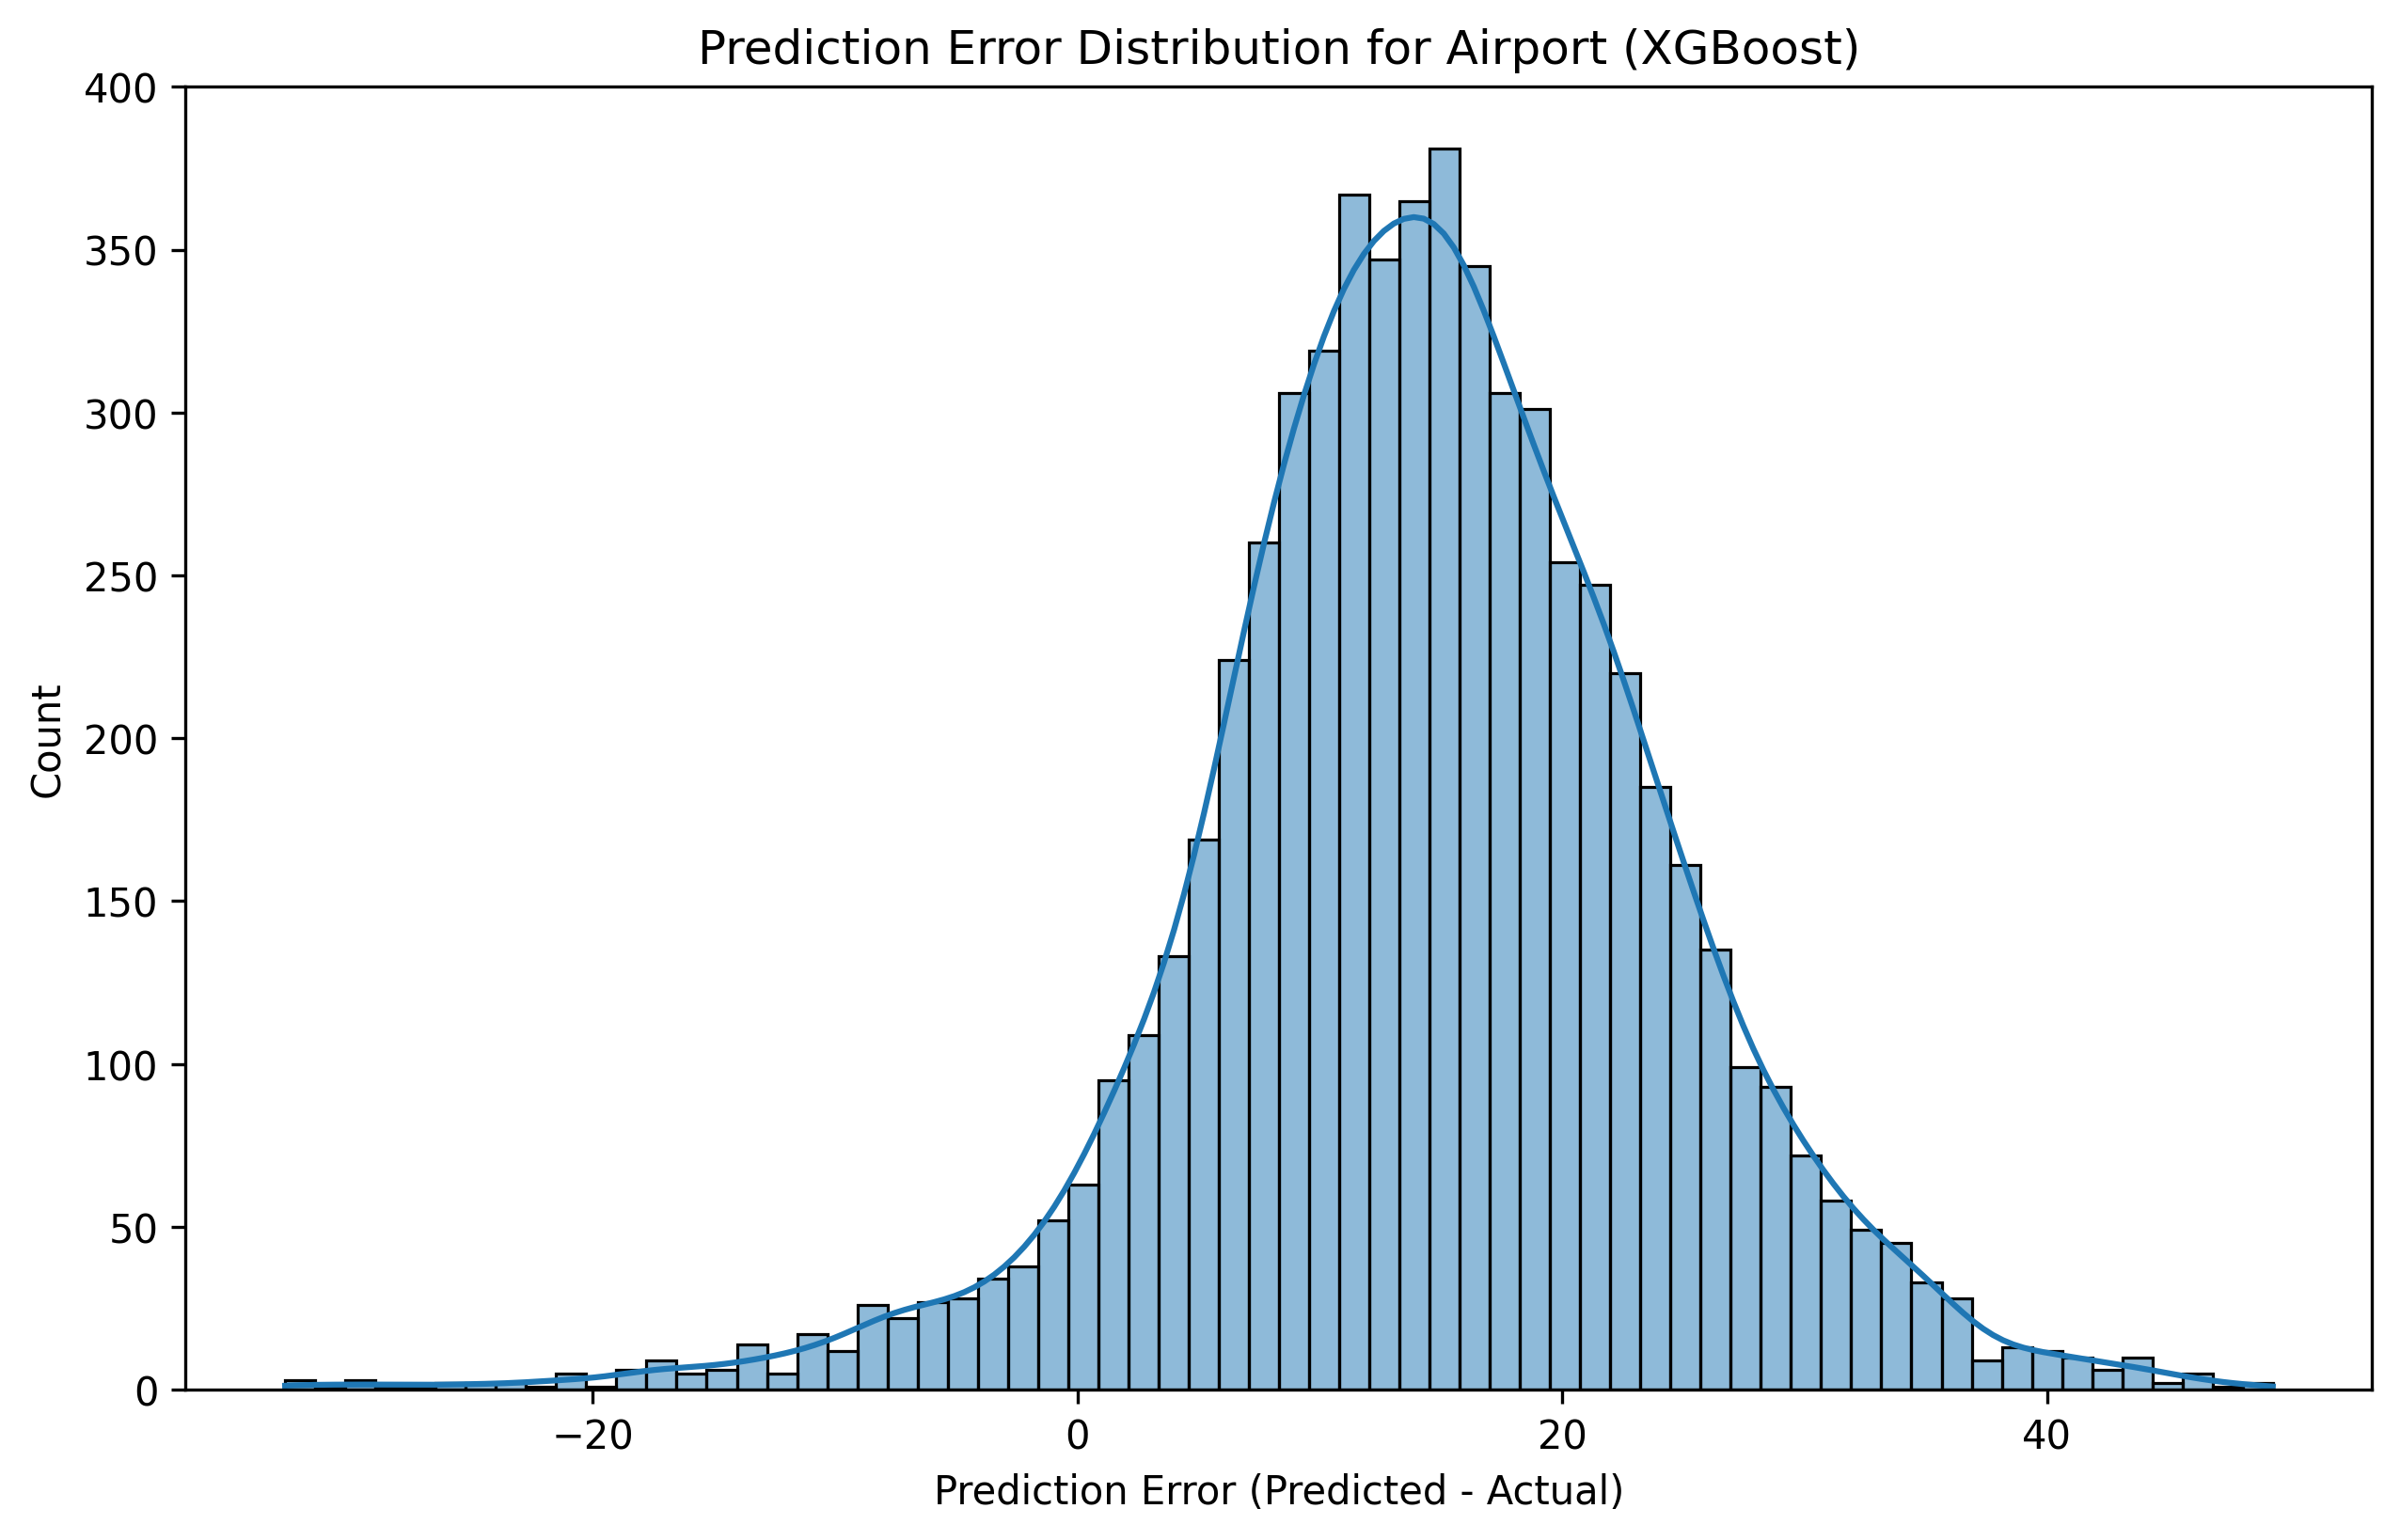
Prediction per region with xgboost
Airport

Slide 9
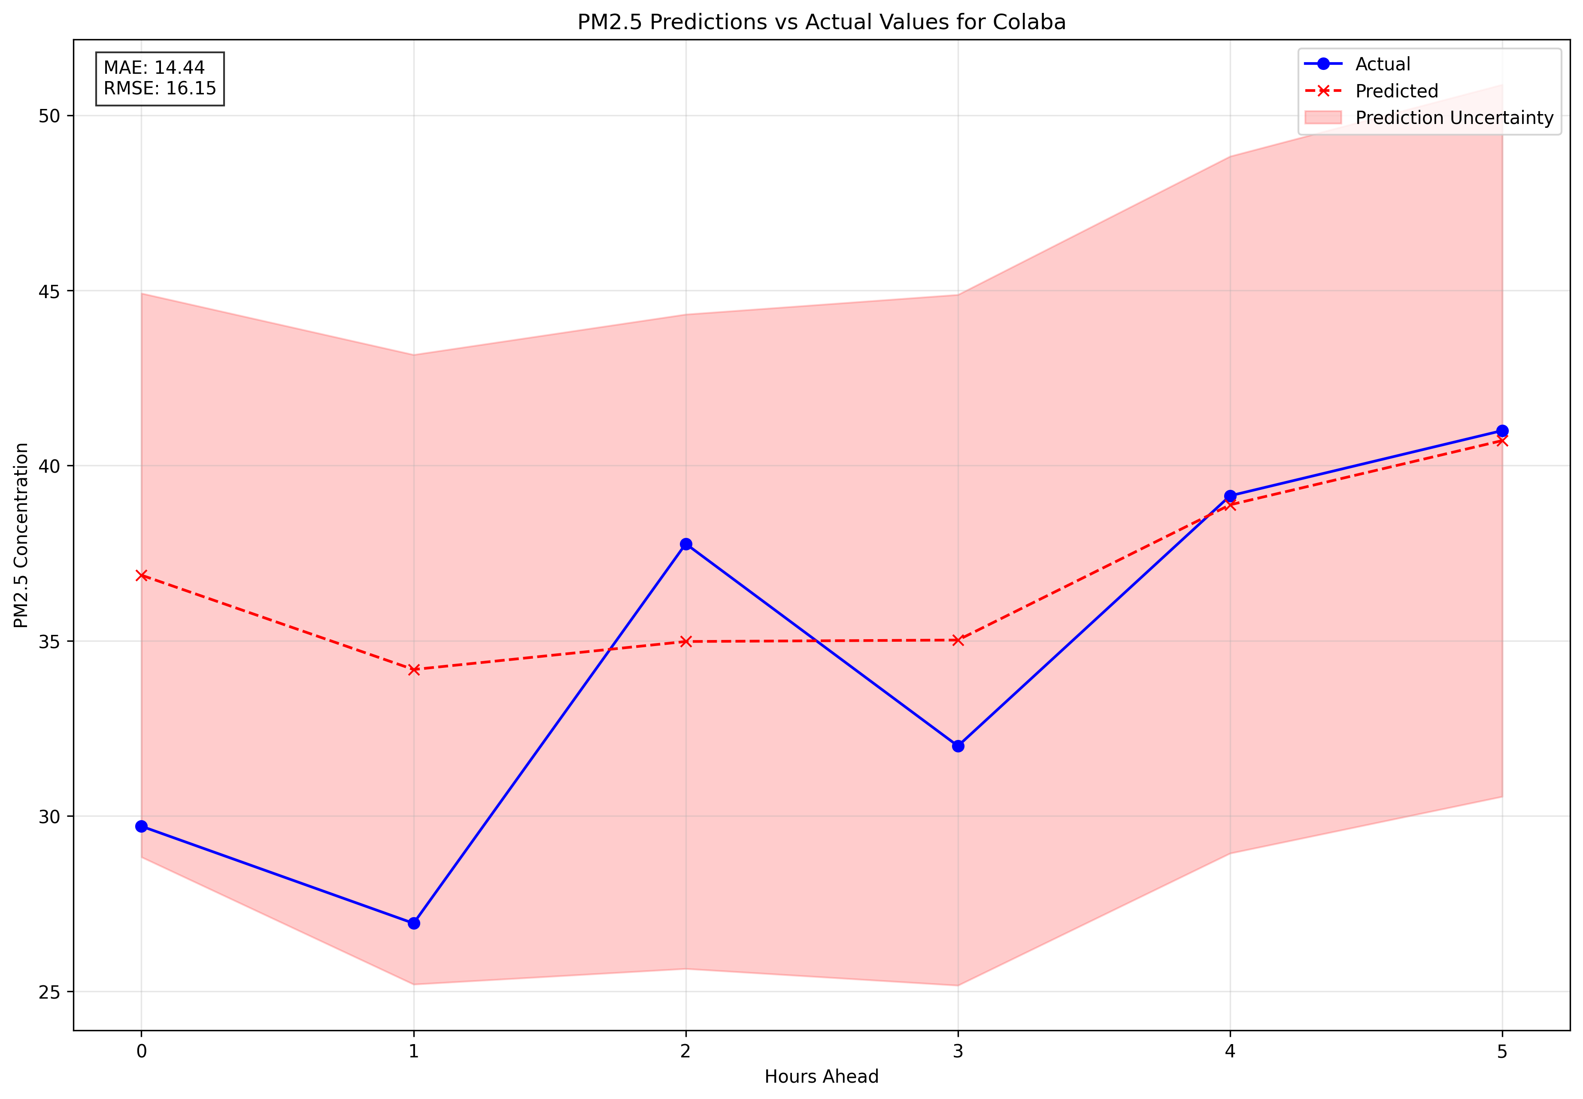
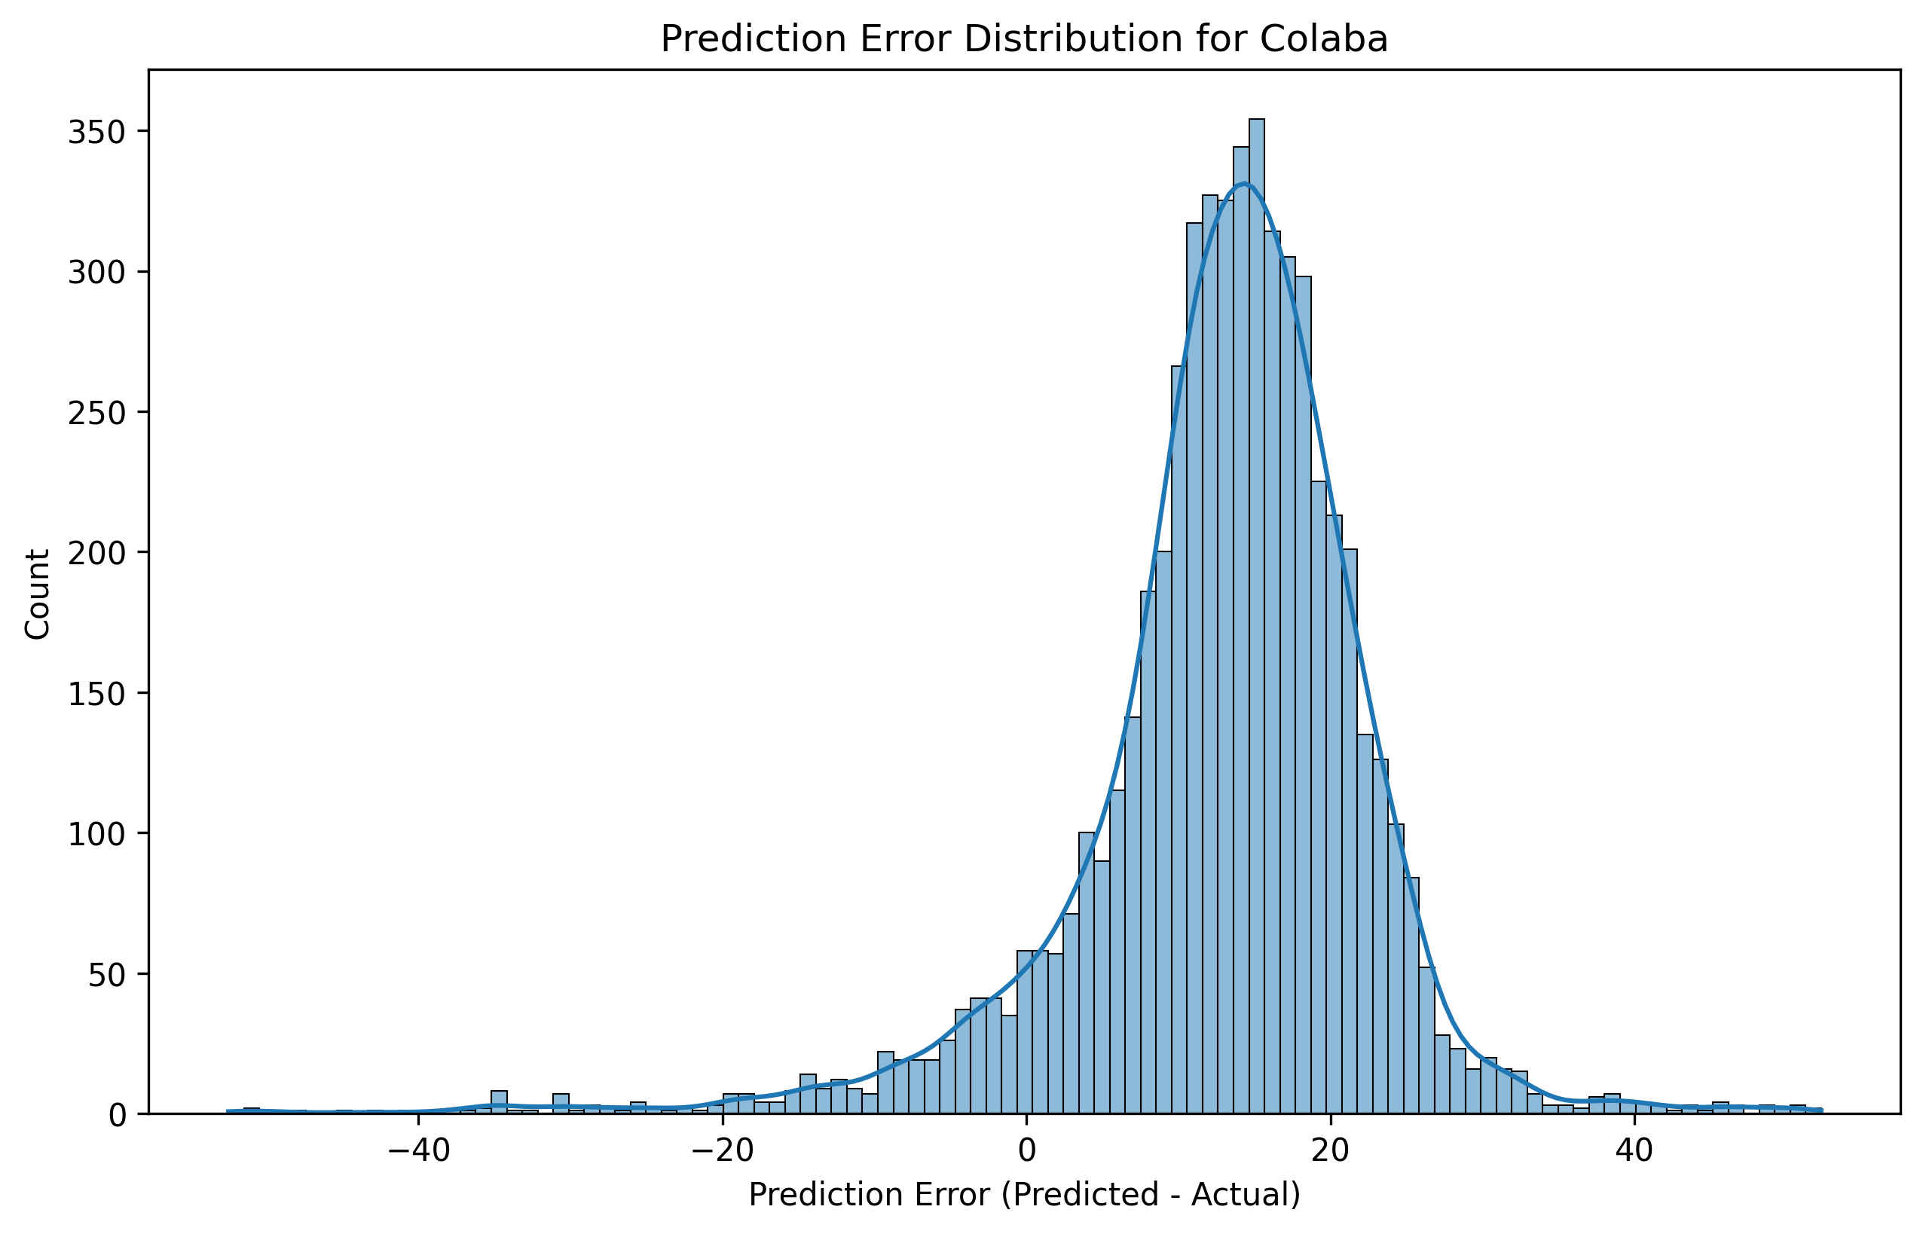
Prediction per region with xgboost
Colaba

Slide 10
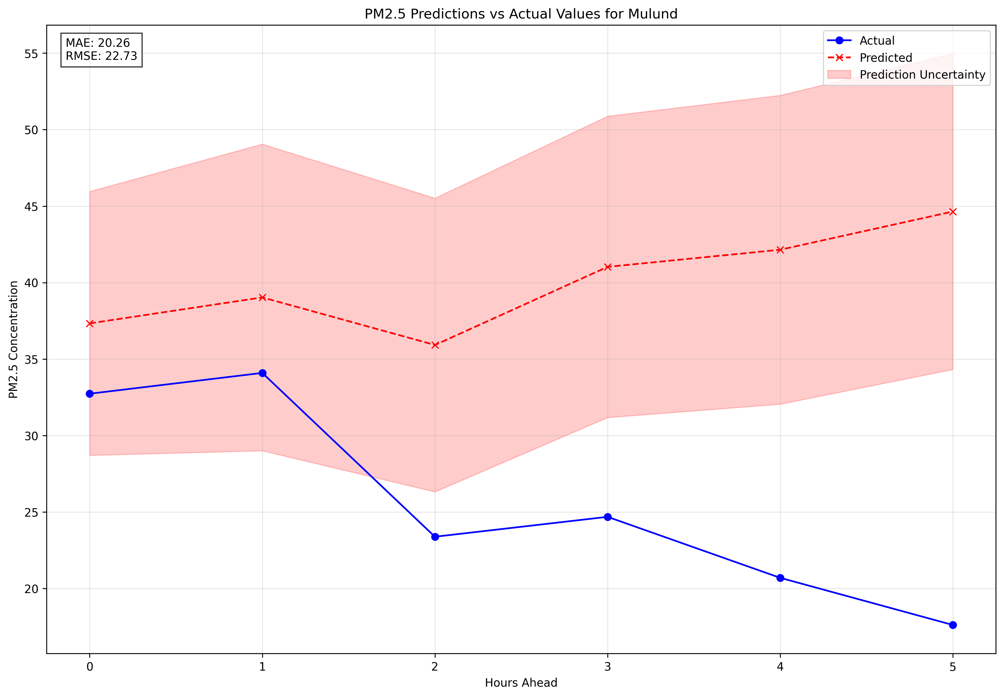
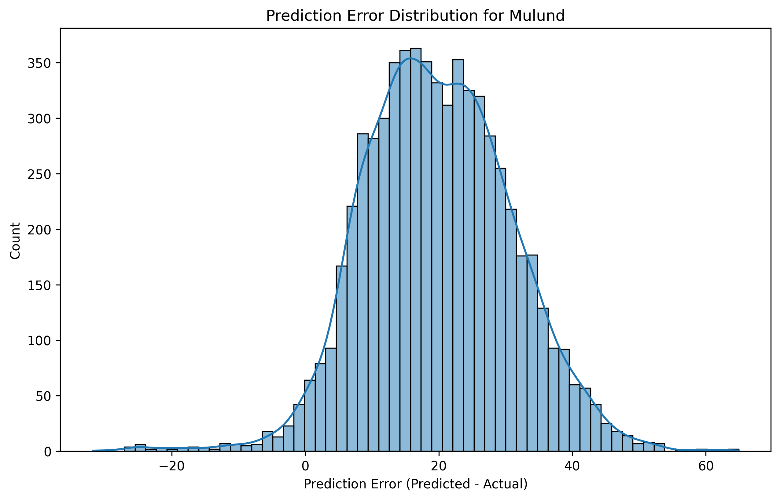
Prediction per region with xgboost
Mulund

Slide 11
Result
Because I had to reduce the size for training the average Mae and RMSE were pretty bad with them being 45 and 55 for this algorithm
Also as seen the predictions get random while predicting further away in the future
As it is very difficult to scale up using this algorithm due to resource issues, deciding to change the algorithm to LSTM going forward as it is not so resource intensive and is traditionally suited for time sequences

